Slide 1
WELCOME
35th Annual CLE Update
December 9th
Randy Carver
Carver Financial Services | 7473 Center St. Mentor OH 44060 | 440.974.0808 | carverfinancialservices.com
Securities offered through Raymond James Financial Services Inc. Member FINRA/SIPC. Investment advisory services are offered through Raymond James Financial Services Advisors, Inc. Carver Financial Services, Inc. is not a registered broker/dealer and is independent of Raymond James Financial Services.

Slide 2
FOCUS IN 2023
Impact Mid Term Election
Tax Policy 2022 & Beyond
Supply Chain & Covid-19
CARVER FINANCIAL SERVICES
2
Notes:
Asking what the market’s going to do is not the most important question - The question is – How will what the market does impact my lifestyle… .
We don’t know what will happen longer term, but with our process doesn’t matter.
People often focus on the wrong risks - Market Crash

Slide 3
ASKING THE RIGHT QUESTION
Notes:
Asking what the market’s going to do is not the most important question
The question is – How will what the market does impact my lifestyle… .
We don’t know what will happen longer term, but with our process doesn’t matter.
People often focus on the wrong risks

Slide 4
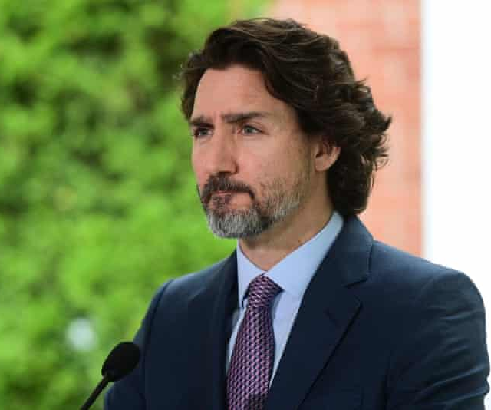
Justin Trudeau
Davos 2/5/2018
The pace of change has never been this fast, yet it will never be this slow again. There’s enormous opportunity and potential in that realization. Technology has always brought such promise. But it also brings dramatic shifts in our social, economic and political cultures.
CARVER FINANCIAL SERVICES
4

Slide 5
THE ROLE OF THE MEDIA IS NOT TO INFORM BUT TO SELL
8,500
Magazines and newspapers
1,761
Commercial TV stations
192
Million active websites
CARVER FINANCIAL SERVICES
5
Notes:
We tend to have an exaggerated and overly-negative view of the world, which can create unnecessary fear and stress, may not reflect things as they truly are and lead to poor decisions.

Slide 6
Dow Drops 410 points, down 23% in 2020, worst first quarter ever – CNBC March 31, 2020
March 1, 2020 The DOW Was At 21,917
November 1, 2021 the DOW was at 35,601
Dow and US Stock plunge again – CNBC March 17, 2020
A Gain Of 62%
Spiraling Virus Fears are Causing Financial Carnage – New York Times March 6, 2020
CARVER FINANCIAL SERVICES
6
Notes:
WE WILL SEE A MARKET CRASH AND IT’S A GOOD THING!

Slide 7
AVERAGE MARKET VOLATILITY
5%
About every 2 months
10%
About every 8 months
20%
About every 30 months
Market corrections 1928 –2018
CARVER FINANCIAL SERVICES
7

Slide 8
History of U.S. Bear & Bull Markets
Daily Returns Since 1942
This chart shows daily historical performance of the S&P 500 Index throughout the U.S. Bull and Bear Markets since 1942. We believe looking at the history of the market’s expansions and recessions helps to gain a fresh perspective on the benefits of investing for the long-term.
The average Bull Market period lasted 4.4 years with an average cumulative total return of 155.7%.
The average Bear Market period lasted 11.1 months with an average cumulative loss of -31.7%.
BULL
From the lowest close reached after the market has fallen 20% or more, to the next market high.
BEAR
When the index closes at least 20% down from its previous high close, through the lowest close reached after it has fallen 20% or more.
S&P 500 Index Total Return (Logarithmic Scale)
Duration
10
Duration
% Total Return
% Annualized
% Total Return
% Annualized*
12.3 Yrs 582.1% 16.9%
11.0 Yrs 400.5% 15.8%
4.1 Yrs 157.7% 26.1%
7.1 Yrs 267.1% 20.0%
3.6 Yrs 79.8% 17.6%
6.2 Yrs 125.6% 14.1%
5.0 Yrs 228.8% 26.7%
5.0 Yrs 101.5% 15.0%
1.5 Mos
1.8 Yrs 114.4% 53.5%
4.1 Yrs
2.1 Yrs 48.0% 20.1%
2.6 Yrs
24.2%
1.1 Yrs 23.9% 22.1%
86.4%
73.5%
16.2%
23.3%
3.4 Mos
21.4%
1
_{11.6 Mos} 11.9 Mos
1.2 Yrs
-21.6%
-18.1%
6.4 Mos
7.9 Mos
1.7 Yrs
3.3 Mos
-33.5%
1.5 Yrs
-36.8%
-26.5%
9.0 Mos
-33.8%
2.0 Mos
-27.6%
1.1 Mos
-33.9%
8.8 Mos
-25.2%
-28.5%
-20.6%
-28.0%
-22.2% 1.5 Yrs
-27.1%
-36.1%
1.7 Yrs
-16.9%
1.1 Yrs
-26.1%
-48.2%
-51.9%
-31.7%
-48.2%
0.1
1942
1947
1952
1957
1962
1967
1972
1977
1982
1987
1992
1997
2002
2007
2012
2017
2022
Bull Market Bear Market Recession
Source: First Trust Advisors L.P., Bloomberg. Daily returns from 4/29/1942 - 9/30/2022. *No annualized return shown if duration is less than one year. Past performance is no guarantee of future results. These results are based on daily returns–returns using different periods would produce different results. The S&P 500 Index is an unmanaged index of 500 companies used to measure large-cap U.S. stock market performance. Investors cannot invest directly in an index. Index returns do not reflect any fees, expenses, or sales charges. This chart is for illustrative purposes only and not indicative
of any actual investment. These returns were the result of certain market factors and events which may not be repeated in the future.
CARVER FINANCIAL SERVICES
8

Slide 9
Staying the Course
Investors tend to see short-term volatility as the enemy. Volatility may lead many investors to move money out of the market and “sit on the sidelines” until things “calm down.” Although this approach may appear to solve one problem, it creates several others:
When do you get back in? You must make two correct decisions back-to-back; when to get out and when to get back in.
By going to the sidelines you may be missing a potential rebound. This is not historically unprecedented; see chart below.
By going to the sidelines you could be not only missing a potential rebound, but all the potential growth on that money going forward.
We believe the wiser course of action is to review your plan with your financial professional and from there, decide if any action is indeed necessary. This placates the natural desire to “do something,” but helps keep emotions in check.
INTRA-YEAR DECLINES VS. C ALENDAR YEAR RETURNS
Volatility is not a recent phenomenon. Each year, one can expect the market to experience a significant correction, which for the S&P 500 has averaged approximately 14% since 1980. History has shown that those who chose to stay the course were rewarded for their patience more often than not.
34%
31%
27%
30%
29%
26%
26%
27%
26%
26%
23%
27%
17%
20%
20%
19%
16%
15%
15%
12%
14%
13%
13%
11%
10%
4%
7%
9%
-10%
1%
2%
-7%
-2%
-10% -13% -23%
3%
4%
-38%
0%
-1%
-6%
-25%
-7%
-8% _{-9%}
-8% -8%
-6% -6% ^{-5%}
-3%
-8%
-11%
-6%
-7%
-3%
-7%
-5%
-13%
-9%
-12%
-14%
^{-8% -7% -8%} -10%
-10%
-12%
-11%
-17% _{-18%}
-17%
-20%
-19%
-17%
-16%
-19%
-20%
-30%
-28%
-25%
-34%
-34%
-34%
-49%
'80 '81 '82 '83 '84 '85 '86 '87 '88 '89 '90 '91 '92 '93
'94 '95 '96 '97 '98 '99 '00 '01 '02 '03 '04 '05 '06 '07 '08 '09 '10 '11 '12 '13
Intra-Year Declines Calendar Year Returns
'14 '15 '16 '17 '18 '19 '20 '21 '22*
Source: Bloomberg, First Trust Advisors L.P. *As of 9/30/2022. Past performance is no guarantee of future results. The benchmark used for the above chart is the S&P 500 Index. The S&P 500 Index is an unmanaged index of 500 companies used to measure large-cap U.S. stock market performance. Investors cannot invest directly in an index. Index returns do not reflect any fees, expenses, or sales charges. Returns are based on price only and do not include dividends. This chart is for illustrative purposes only and not indicative of any actual investment. These returns were the result of certain market factors and events which may not be repeated in the future.
9
CARVER FINANCIAL SERVICES

Slide 10
96%
Of market gains came from just 0.9% of trading days
135
Just 135 Days out of 14,830 Days From 1963 – 2004
CARVER FINANCIAL SERVICES
10
Notes:
1963 - 2004

Slide 11
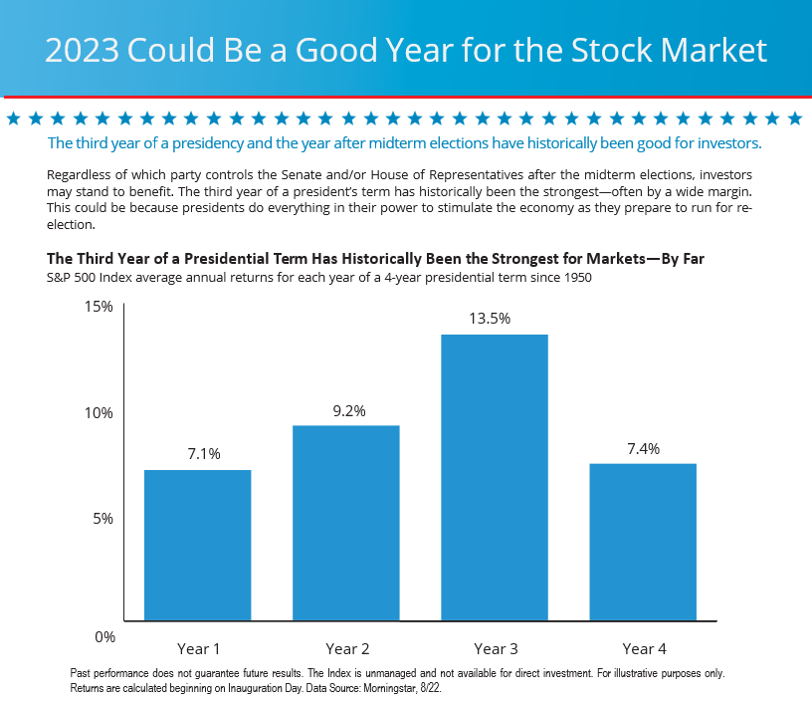
11

Slide 12
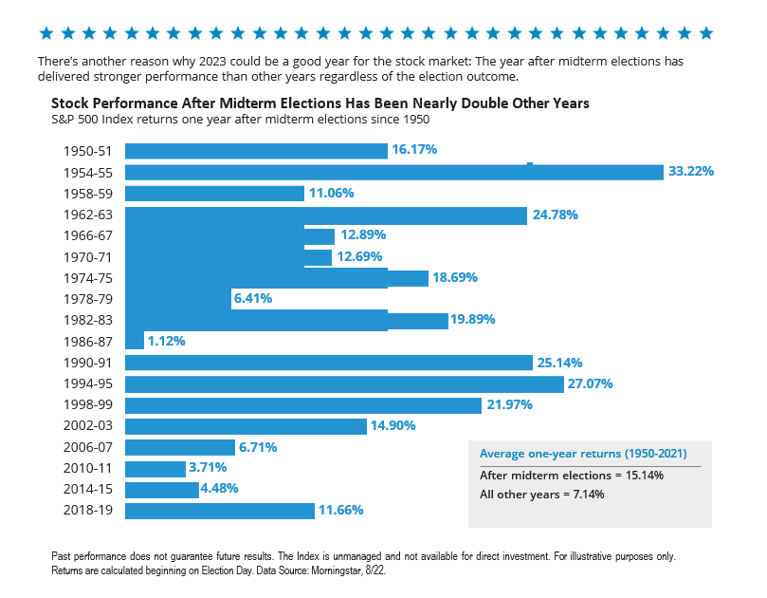
12

Slide 13
2023 Tax Proposal and Budget
The major tax proposals include:
Corporate income, and capital gains income
Ending step-up in basis by making death a taxable event
Expanding the base of the Net Investment Income Tax (NIIT) to apply to active pass-through income and making the active pass-through business loss limitation permanent
Major changes to international taxation
A laundry list of new minimum taxes for individuals, businesses, and international corporations
13
CARVER FINANCIAL SERVICES

Slide 14
Current Tax Environment
Post-TCJA taxpayers are experiencing lower marginal tax rates
Taxpayers should prepare themselves for the threat of higher taxes, and pursue strategies to hedge that risk whenever possible and reasonable
Potential changes to reduce tax and estate planning opportunities 2023
14
CARVER FINANCIAL SERVICES
Notes:
Currently taxpayers benefit from a relatively favourable policy environment. However, there is a risk of higher taxes in the not so distant future as the current rates expire and the government seeks additional revenue to offset spending.

Slide 15
New 3% Surtax – Expansion 3.8% Surtax
New 3% Surtax on income - Households with income over $5 Mil. MAGI starting 2022
3.8% expanded to active business income for single taxpayer $400k Magi/Joint $500k (currently only passive income from passthrough)
15
CARVER FINANCIAL SERVICES

Slide 16
Restrictions on Large IRA Balances
Once balance of IRA & Defined Contribution Plan exceeds $10 mil no additional contributions are allowed
RMD is immediate on 50% of amount over $10 mil
Applies only to taxpayers with income over $400k – Single/$450k – Joint
Additional rules aggregate over $20 mil
16
CARVER FINANCIAL SERVICES

Slide 17
ROTH Conversions Disallowed
ROTH conversions only on pre-tax funds – eliminates Back Door ROTH
Also prohibits transfer of after-tax funds in DC plan to ROTH – eliminates Mega Back Door ROTH
No ROTH conversions at all for taxpayers with $400k Single/$450k Joint MAJI
17
CARVER FINANCIAL SERVICES

Slide 18
Taxing capital gains at ordinary income tax rates would bring the combined top marginal rate in the U.S. to 48.9 percent, up from 29.2 percent under current law and well-above the OECD average of 18.9 percent.
Biden’s proposal for a complicated “Billionaire Minimum Tax” would bring unrealized gains into the tax base on an annual basis, which is also out of step with international norms.
Raising the corporate income tax rate to 28 percent would once again bring the U.S. near the top of the OECD at a combined rate of 32.3 percent, versus 25.8 percent under current law and an OECD average (excluding the U.S.) of 22.8 percent.
CARVER FINANCIAL SERVICES 14

Slide 19
Other Sun Setting
Unified Credit in 2026 – back to $ 6mil
The TCJA made significant changes to individual income taxes as well as estate and gift taxes. For individual taxpayers, almost all these provisions expire or “sunset” at the end of 2025.
Top tax rate from 37% to 39.65
Potentially eliminate step-up of basis on all or part of Estates
19
CARVER FINANCIAL SERVICES

Slide 20
HIGHER TAX LIKELY – HOW DO WE COMBAT
Cash Balance Plans
Direct Indexing
CARVER FINANCIAL SERVICES
20

Slide 21
RESOURCES
FOR YOU
Notes:
Asking what the market’s going to do is not the most important question
The question is – How will what the market does impact my lifestyle… .
We don’t know what will happen longer term, but with our process doesn’t matter.
People often focus on the wrong risks

Slide 22
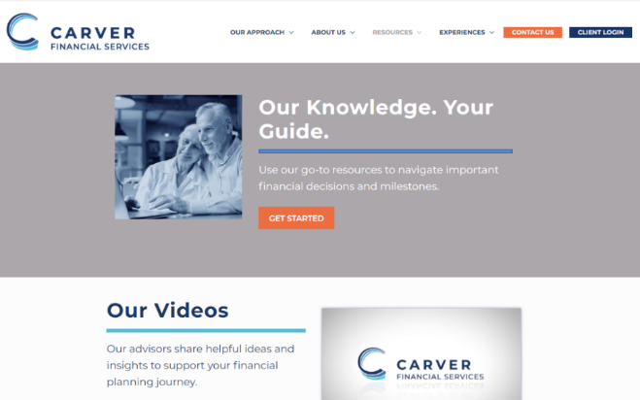
WEBSITE RESOURCES
Our Videos
Client Communications
Client Access
FAQ
Experiences
CARVER FINANCIAL SERVICES
22

Slide 23
Your Vision Our Priority
Your Success Our Mission

Slide 24
Thank You For Attending
24
CARVER FINANCIAL SERVICES

Slide 25
DISCLOSURES
This material is being provided for information purposes only and is not a complete description, nor is it a recommendation to buy or sell any investment. Investing involves risk and investors may incur a profit or loss regardless of strategy selected. The information has been obtained from sources considered to be reliable, but Raymond James does not guarantee that the foregoing material is accurate or complete. Any opinions are those of the presenters and not necessarily those of RJFS or Raymond James.
Investors should consult with a financial advisor and consider their investment goals, risk tolerance and time horizon before making any investment decision. Investing in the energy sector involves special risks, including the potential adverse effects of state and federal regulation and may not be suitable for all investors. Past Performance is not a guarantee of future results. There is no guarantee that these statements, opinions or forecasts provided will prove to be correct.
This information is not meant as tax or legal advice. Investors should consult a professional advisor before making investment and financial decisions and for more information on tax rules and other laws, which are complex and subject to change.

