Slide 1
DiCello Levitt
Birmingham | Chicago | Cleveland | New York | Washington D.C.
www.dicellolevitt.com

Slide 2
Trends in Civil Litigation
Justin J. Hawal
Peter C. Soldato
Justin S. Abbarno

Slide 3
Trial Depositions in Modern Court Rooms
Justin S. Abbarno

Slide 4
Ohio Civ. R. 32
Use of depositions. Every deposition intended to be presented as evidence must be filed at least one day before the day of trial or hearing unless for good cause shown the court permits a later filing.
At the trial or upon the hearing of a motion or an interlocutory proceeding, any part or all of a deposition, so far as admissible under the rules of evidence applied as though the witness were then present and testifying, may be used against any party who was present or represented at the taking of the deposition or who had reasonable notice thereof, in accordance with any one of the following provisions:

Slide 5
Ohio Civ. R. 32
(3)(a) that the witness is dead; or
(b) that the witness is beyond the subpoena power of the court in which the action is pending or resides outside of the county in which the action is pending unless it appears that the absence of the witness was procured by the party offering the deposition; or
(c) that the witness is unable to attend or testify because of age, sickness, infirmity, or imprisonment; or
(d) that the party offering the deposition has been unable to procure the attendance of the witness by subpoena; or
(e) that the witness is an attending physician or medical expert, although residing within the county in which the action is heard; or
(f) that the oral examination of a witness is not required; or
(g) upon application and notice, that such exceptional circumstances exist as to make it desirable, in the interest of justice and with due regard to the importance of presenting the testimony of witnesses orally in open court, to allow the deposition to be used.

Slide 8
Pros
Cons
$$$
Witness Comfort
Cut down in trial work
Get ahead on your trial preparation!
Not a live witness
Juror attention
Cannot respond to live testimony with follow up questions

Slide 9
What to Watch Out For
Will your court let you use video to present your trial deposition?
Will opposing counsel agree?
Is the witness willing to give a video trial deposition?

Slide 10
Discovery Deposition v. Trial Deposition
Trends in civil litigation to require advance approval by opposing counsel
Opposing party generally must have the opportunity to cross examine.
Notes:
Example: Deposition of a treating physician taken by opposing counsel. Upon request to use the deposition at trial, opposing counsel denied the request and required a trial deposition to be taken if the treating physician would be unavailable for trial.
“Discovery depositions present counsel, using a card game analogy, with an opportunity to see the other party’s hand, not to necessarily show off one’s own cards.” John S. Austin, Raleigh, NC, co-chair of the ABA Trial Practice Committee

Slide 11
Best Practices
Get a videographer or a good quality video camera
Solid background
Focus the camera only on the witness
Cut your own video to cut your costs
Address objections with the court with your motions in limine
Get agreement with opposing counsel where possible to limit the number of objections

Slide 12
Conducting Effective Legal Research Using Digital Platforms
Justin J. Hawal

Slide 13
Legal Research Databases
Westlaw (Paid)
LexisNexis (Paid)
Bloomberg Law (Paid)
Court Listener (Free)
Casetext (Free)
Caselaw Access Project (CAP) (Free)
FindLaw (Free)
Justia (Free)
Law Library of Congress (Free)

Slide 14
Basic Search Methods
Natural Language Searching vs. Terms and Connectors Searching
Knowing how each method works will allow you to determine which method will be more effective
The method that is most effective may depend on the issue(s) you're researching
May need to combine methods to yield the results you need

Slide 15
Natural Language Searching
Natural language search is a search that uses regular spoken language, phrasing questions as you would ask them if you were talking to someone.
Default search method for Westlaw, LexisNexis, and Bloomberg. If you type in a string of terms or phrases, the system automatically runs a natural language search.
Uses an algorithm similar to Google or other search engines to parse your search terms and deliver a set of results in relevance order.
Can be effective to find cases involving broad, general legal issues, but you are reliant on an algorithm where you do not know exactly how the database is being searched. Relying too heavily on algorithmic searching can be an inefficient use of time and retrieve a frustrating amount of irrelevant results.

Slide 16
Terms and Connectors Searching (Boolean Search Method)
Allows you to enter query that consists of key terms from your issue and connectors specifying the relationship between those terms.
Allows you to control exactly how the database is being searched.
Allows you to search with more precision and avoid overbroad results containing irrelevant materials.

Slide 17
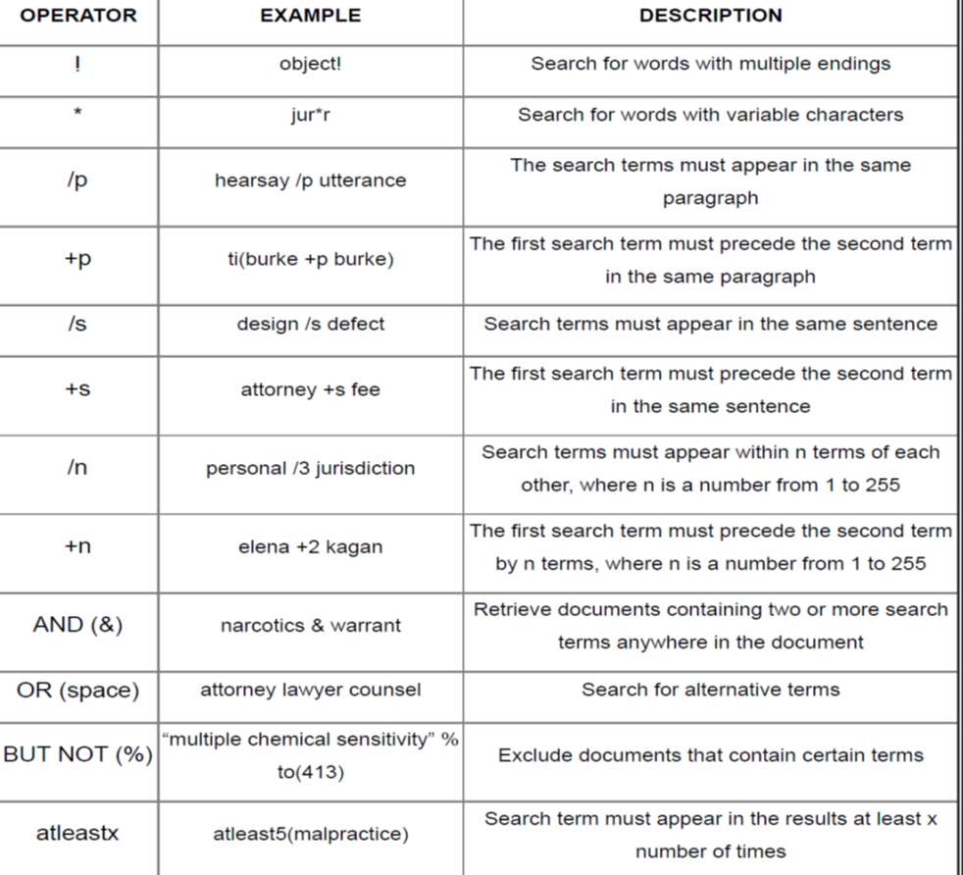
Westlaw Terms and Connectors

Slide 18
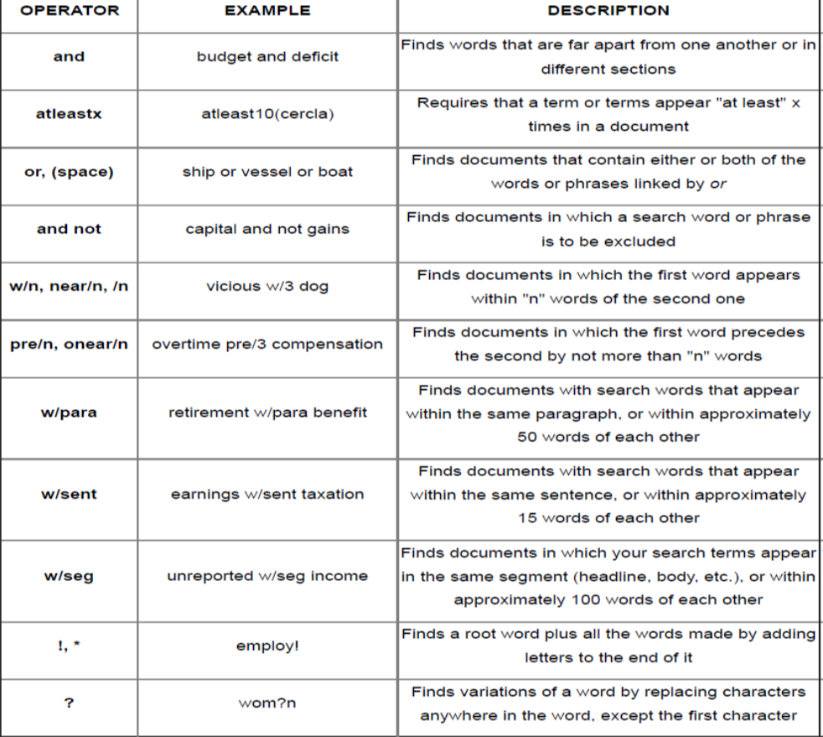
LexisAdvance Terms and Connectors

Slide 19
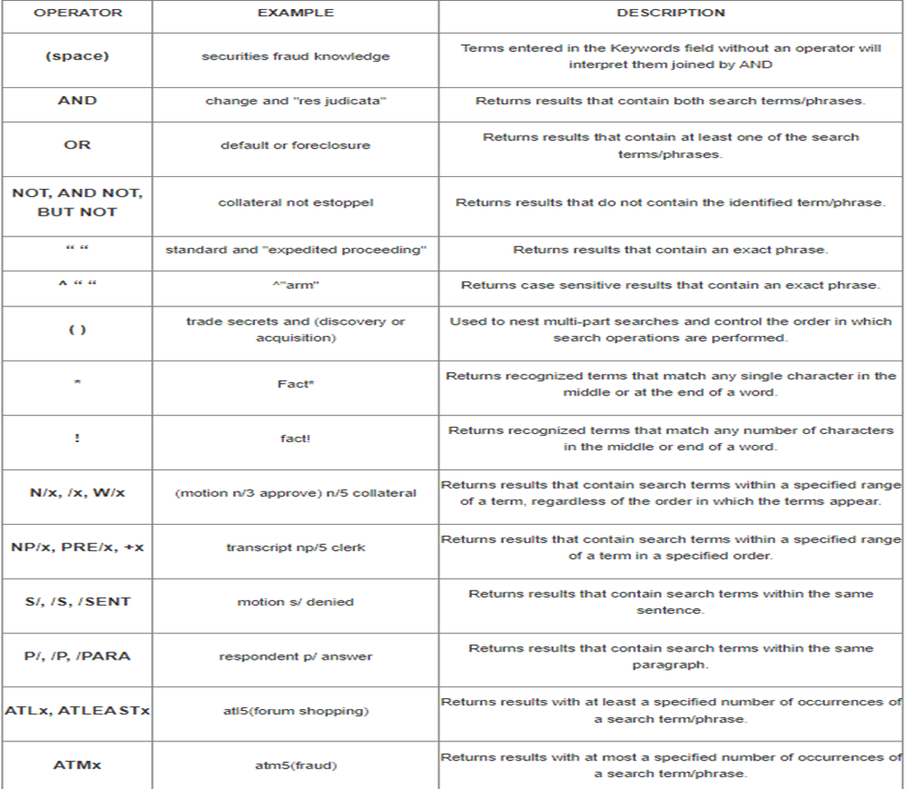
Bloomberg Terms and Connectors

Slide 20
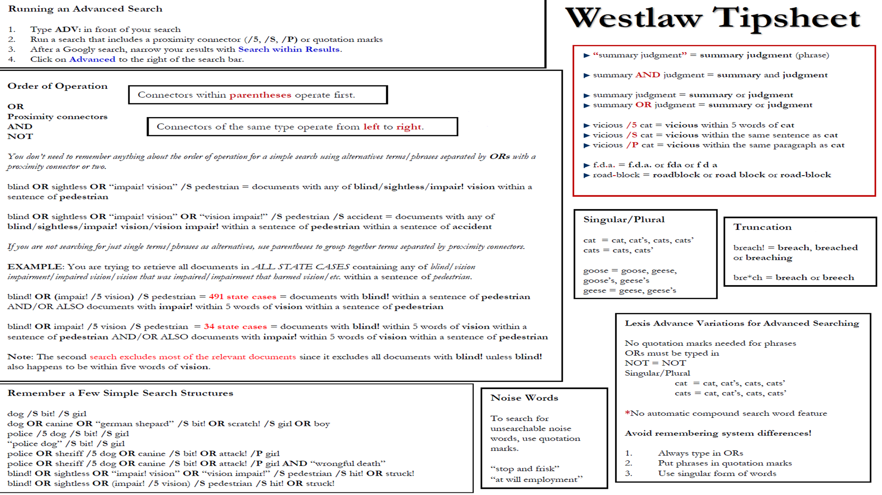

Slide 21
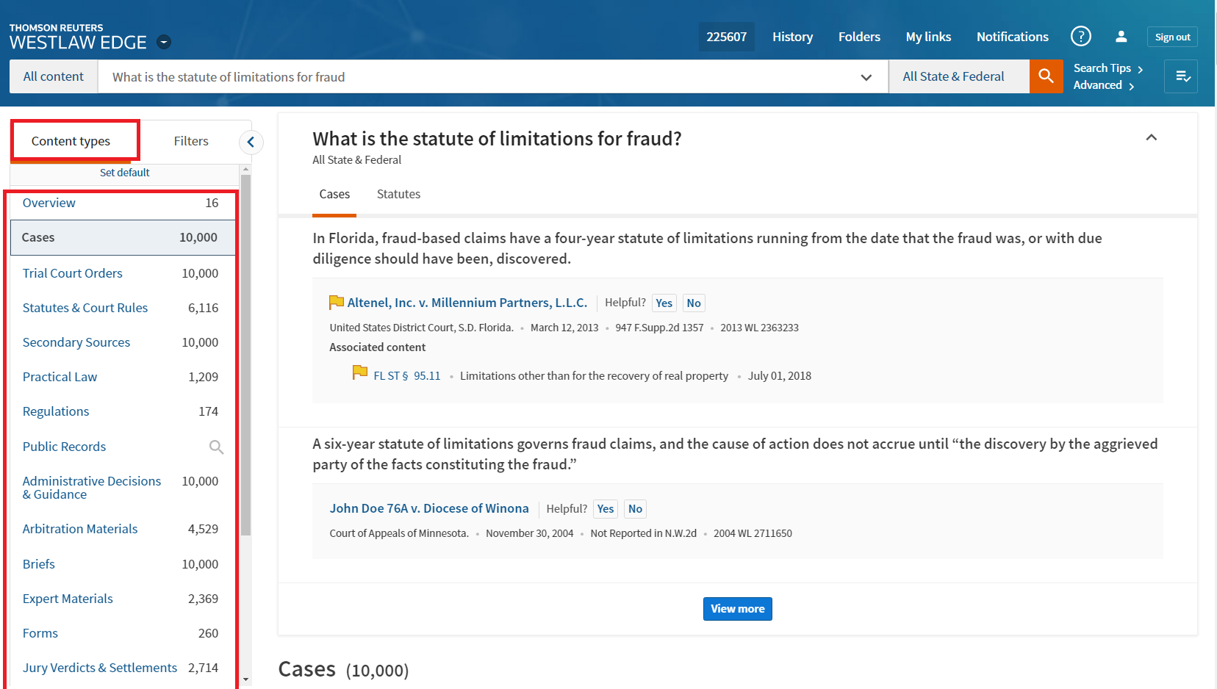
Content Types

Slide 22
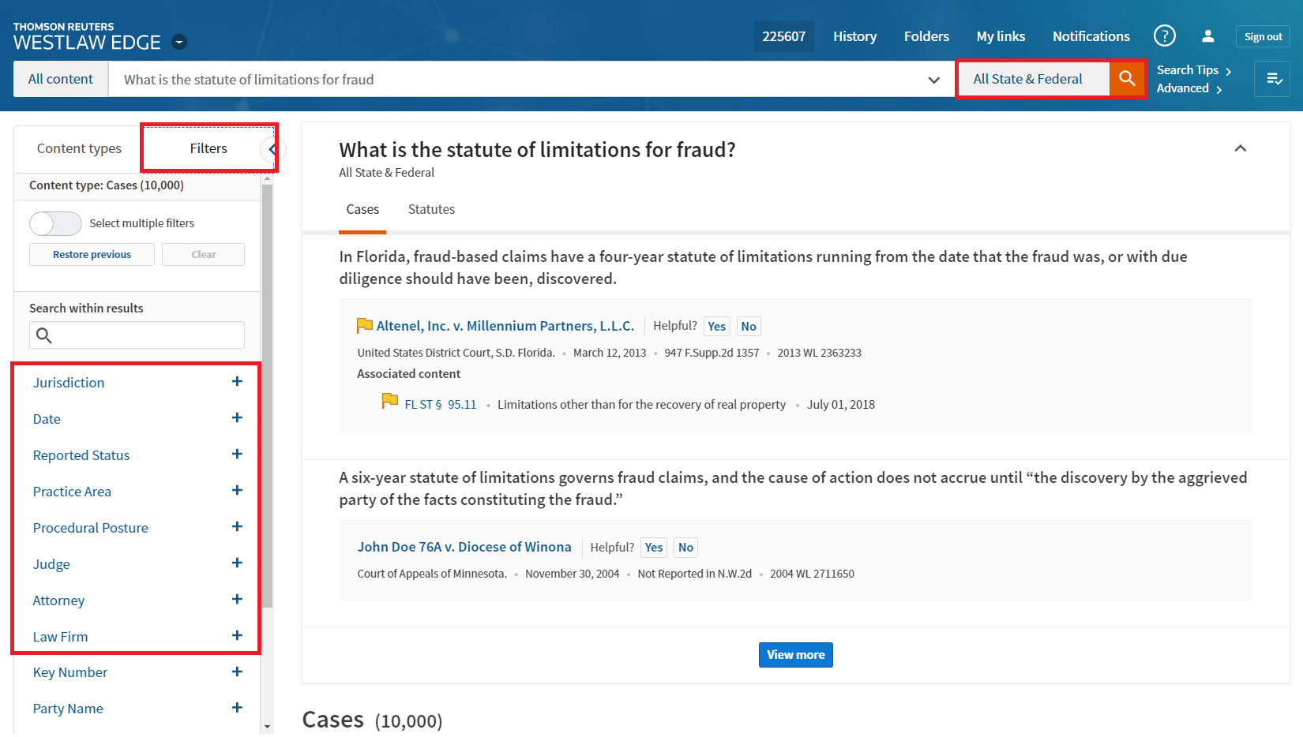
Filtering Options

Slide 23
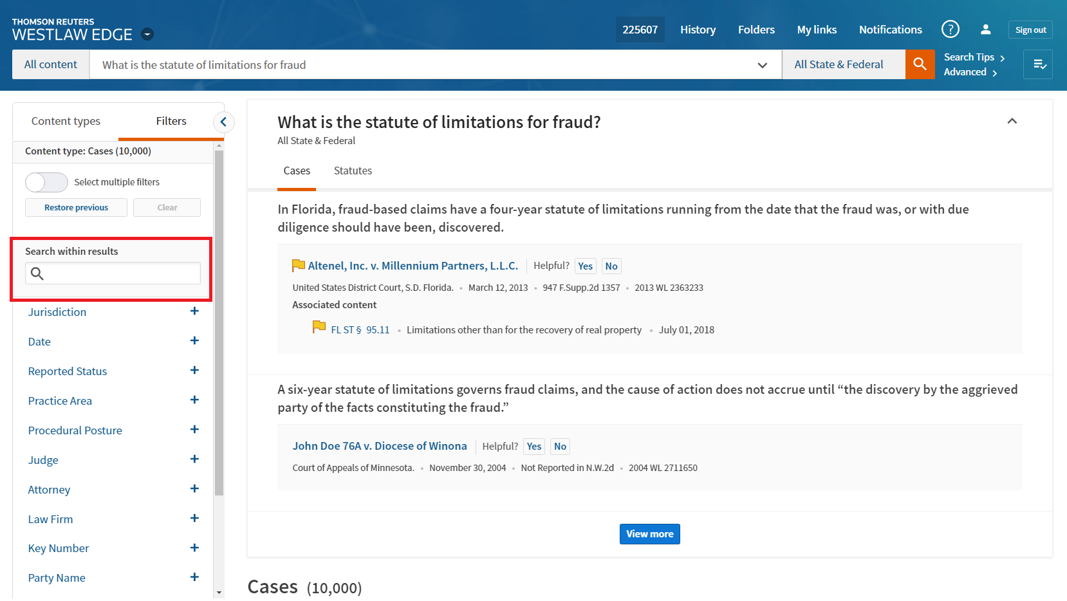
Search Within Results

Slide 24
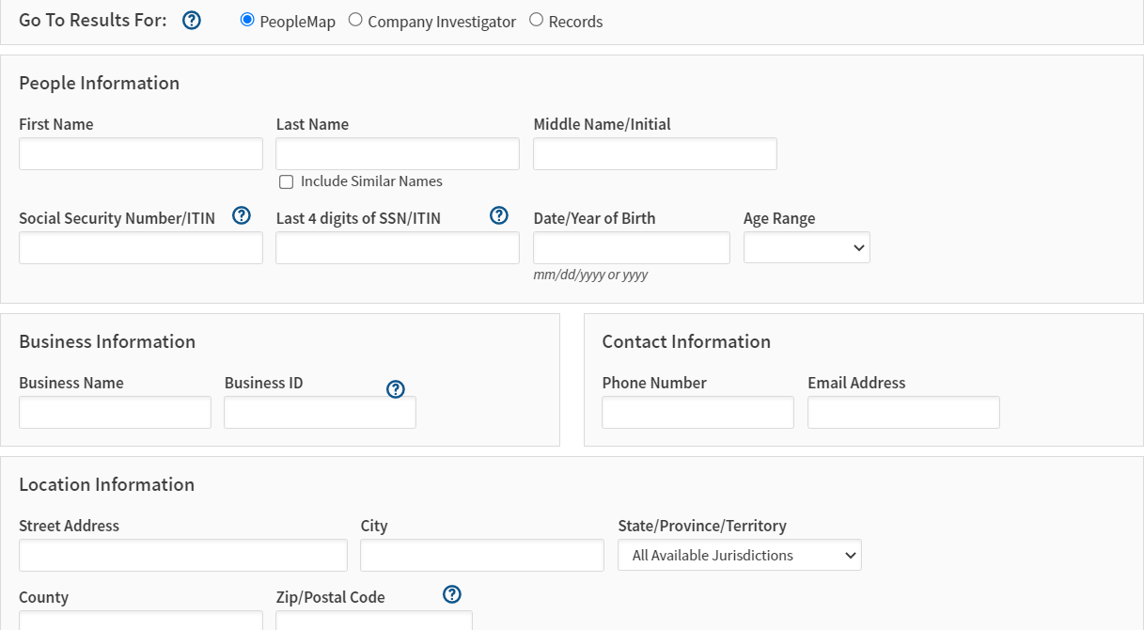
Public Record Searches

Slide 25
Discovering Electronically Stored Information (“ESI”)
Peter C. Soldato
Notes:
- Understanding ESI is essential in modern litigation

Slide 26
The Framework
What is the type of information that you would need?
How is that electronic information created?
Where is that electronic information stored?
How can that electronic information be accessed?
Notes:
Information: file itself, info about who created the file, email, or when an email was sent?

Slide 27
Where is electronic data created and stored?
Computers (workstations, tablets, laptops)
Mobile phones
Cloud storage
Hosted email systems (Gmail, Microsoft Exchange, etc.)
File storage (Dropbox, Microsoft OneDrive, Google Drive)
Server systems (file and email servers, backups, archive servers)
Social media (Facebook, Twitter, and so on)
External storage (USB flash drives, etc.)
Internet of things (electronic door locks, cars, medical devices, etc.)
Source code (underlying programming language that dictates a programs functions)
Electronic medical records (“EMR”) systems containing electronic medical information (“EMI”)
Global positing systems (“GPS”)
Notes:
Internet of things: connecting devices to the internet and other connected devices

Slide 28
Hidden Information
In addition to file content, be aware of these other forms of “hidden” electronic information:
Metadata
System data
Backup data
Deleted files
Residual data
Notes:
Metadata: virtually all ESI has embedded metadata – this houses information about the data in the file, such as when it was created, or edited, and by whom
System data: computer records history of activity on the device, such aslogon information, deletions of files, access of programs, etc.
Backup data: Created for short-term disaster recovery, backup data makes available data that would be otherwise lost.
Deleted files: Deleted data is seldom actually deleted from the computer. Rather, the computer renames the data and moves it to another location within the computer’s hard drive for eventual overwriting when space becomes necessary.
Residual data: When data is being overwritten, portions of the information remain available for reconstruction by a forensic examiner.

Slide 29
The Applicable Legal Rules
Federal Rule of Civil Procedure 26 and 34 dictate the manner that you may obtain ESI
Notes:
34(b)(1)(C): requesting party can require information to be produced in certain forms; ex: files converted into PDFs and then produced may be missing metadata, etc.
- understanding the source of data is critical – tailor request as appropriate

Slide 30
Federal Rule of Civil Procedure 34
(a) In General. A party may serve on any other party a request within the scope of Rule 26(b):
(1) to produce and permit the requesting party or its representative to inspect, copy, test, or sample the following items in the responding party's possession, custody, or control:
(A) any designated documents or electronically stored information—including writings, drawings, graphs, charts, photographs, sound recordings, images, and other data or data compilations—stored in any medium from which information can be obtained either directly or, if necessary, after translation by the responding party into a reasonably usable form; or
(B) any designated tangible things; or
…
(b) Procedure.
(1) Contents of the Request. The request:
(A) must describe with reasonable particularity each item or category of items to be inspected;
(B) must specify a reasonable time, place, and manner for the inspection and for performing the related acts; and
(C) may specify the form or forms in which electronically stored information is to be produced.
Notes:
34(b)(1)(C): requesting party can require information to be produced in certain forms; ex: files converted into PDFs and then produced may be missing metadata, etc.
- understanding the source of data is critical – tailor request as appropriate

Slide 31
Federal Rule of Civil Procedure 34
(b)(2)(E) Producing the Documents or Electronically Stored Information. Unless otherwise stipulated or ordered by the court, these procedures apply to producing documents or electronically stored information:
(i) A party must produce documents as they are kept in the usual course of business or must organize and label them to correspond to the categories in the request;
(ii) If a request does not specify a form for producing electronically stored information, a party must produce it in a form or forms in which it is ordinarily maintained or in a reasonably usable form or forms; and
(iii) A party need not produce the same electronically stored information in more than one form.
Notes:
34(b)(1)(C): requesting party can require information to be produced in certain forms; ex: files converted into PDFs and then produced may be missing metadata, etc.
- understanding the source of data is critical – tailor request as appropriate

Slide 32
“Systems-Based” Discovery Searches
In order to make meaningful requests about ESI discovery to be produced by your opponent, you need to understand the systems that the organization used/uses for creating, storing, and retrieving data
Best way to do this is through a 30(b)(6) deposition

Slide 33
Case Example: The Search for the “Deleted” Email
Rule 30(b)(6) Deposition Topic: “Emails that contain information regarding Harry Potter and the incident that occurred on December 7, 2022 at Hogwarts Health Center, and the creation, storage, and retrieval of such emails”
Notes:
p. 265 depo book

Slide 34
Case Example: The Search for the “Deleted” Email
Describe email system;
Describe archive system;
Describe retention policy;
Describe creation and storage;
Describe deletion and preservation;
Describe search software; and
Describe burden of search.
Notes:
p. 265 depo book

Slide 35
Questions?

